Slide 2
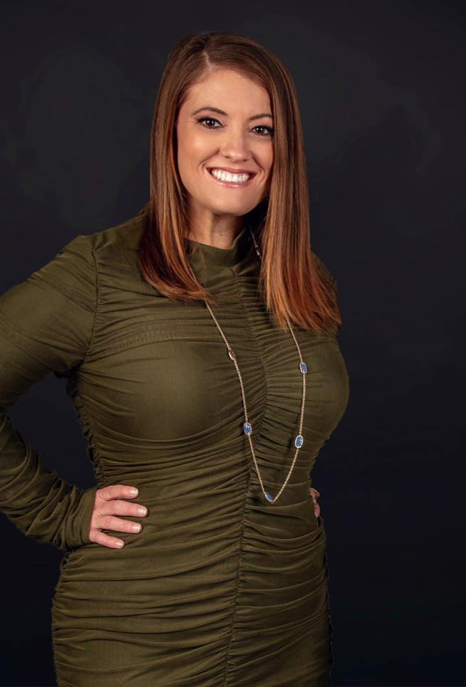
Kim Sixkiller
President, Magellan Healthcare
Using the ‘Thank You Economy’
to execute Medicare Seminars and create an additional, stand-alone leads funnel for your Financial Services Practice

Slide 3
Why Seminars - What’s the Point?
10,000
Baby boomers enter seniors (65+) market daily¹
72,000,000
The number of Americans ages 65 and older is projected by 2030²
Perfect Storm
of
Opportunity
=
2 out of 3
Medicare beneficiaries are adding Medicare Insurance³
Seniors are confused and frustrated by Medicare and need help
¹https://www.investopedia.com/articles/personal-finance/032216/are-we-baby-boomer-retirement-crisis.asp
²https://www.silverbook.org/fact/by-2030-there-will-be-an-estimated-72-1-million-older-americans-almost-doubling-from-2008
³https://www.ahip.org/state-of-medigap-2018/; http://files.kff.org/attachment/Issue-Brief-Medicare-Advantage-2017-Spotlight-Enrollment-Market-Update

Slide 4
Back to Basics: Medicare Seminars 101
There are two types of Medicare Seminars
Educational
MS details are allowed
No MA or PDP product details (CMS regulations apply to these)
HMO vs. PPO and what is the difference, etc.
Meals are allowed at these events - $15 max is better
Does not need to be registered
You can take enrollment forms here
Get permission to contact forms and you can do SOAs here if you want…if you do these well booking appointments are easy
Carrier logos can be present if not discussed but do NOT give out carrier freebies
Sales Specific Seminar (I do not recommend these)
Specific to a carrier and their products offered in your area
If you do these the carrier better be footing the bill unless you leave this unbranded
Light snacks only
Must be registered with the carriers
No enrollment forms here
Community Colleges, Senior Centers, Recreation Centers, Chamber of Commerce Building, Church, Libraries may require you be a non-profit
Provide Coffee, Water bottles, light snacks…
Room fees happen here but don’t pay more than $100 or so
Partner with community groups or non-profits
YOU CAN HAVE A REGISTERED SALES EVENT THAT HAPPENS AFTER YOUR EDUCATIONAL EVENT IF YOU WANT
PEOPLE KNOW THE DIFFERENCE BETWEEN A SALESMAN AND AN EDUCATOR AND PEOPLE DON’T LIKE TO BE SOLD

Slide 5
Where to do Seminars?
Find a room big enough for 25-50 people
Steakhouses and buffet pull the best - stay under $15/person
DO NOT PAY A ROOM FEE…FIND A FEW PLACES THAT’LL GIVE THE ROOM AND WITH COVID YOU CAN GET THESE, ESPECIALLY AT LUNCH TIME
Deal with your minimums…have them agree to do gift cards for this
You can place a rolling deposit that can roll forward OR apply to gift card ($150 max)
Partner with community groups or non-profits
PAY THE BILL BEFORE 11 AM AND YOU GET THE EARLY BIRD PRICES…
Restaurant relationship will be game changing: TIP WELL, TAKE CARE OF THOSE SERVERS SO THEY WANT TO SERVE YOUR EVENTS … TIP MANAGER IF THEY HELP OUT … CASH BILLS
MARKETING IS A COMPOUNDING INVESTMENT
YOUR CPA AND ROI IS A LONG-TERM BREAK EVEN BECAUSE THESE SALES STAY ON THE BOOK ON AVERAGE AT LEAST 4 YRS
CPA IS AROUND $70 … WHERE ELSE CAN YOU DO THIS

Slide 6
When to do Seminars?
Tuesday/Thursday are the best for dinners
Wednesdays are ok for dinner but less pull because of church commitments
Ron runs weekday lunches
Justin runs dinners only
Prospecting is during this only – phone appointment is booked by calling and saying hey it is time and give them options to pick from

Slide 7
How do you fill your Seminars?
Lead mailers are King for t65 – they are laser precise
Viral isn’t great because your spots can fill up with unqualified leads….and there is NOTHING you can do about this
Send a 6x9 full color postcard: Add a QR code or landing page link
Leading Response (SAM discount)
September Setting Example: Exclude Sept/Oct/Nov B-Days
Focus on Dec – May with a radius around the venue
Looking to get a 1.5 – 2.5 % response rate
1k mailers equals 15-20 people in the room
No PO Boxes
Financial Planners want hirer wage earners so go 50k + but you don’t have to
Two follow-up calls: Confirm dietary restrictions and reminder call

Slide 8
What do you need for Seminar EXECUTION?
AEP Seminars Digital Ads are great because 64 ½ and up is perfect
Facebook data is less accurate than it once was so don’t use for t65
Intent is often lower for digital because you click without the same commitment as calling on a piece of direct mail…
Direct mail is passive but requires more action to go to a web or call someone to book in
Powerpoint or Posters: You can give your slides if you’d like but people split hairs on whether you should do this or not
HTMI cable or a back-up plan unless you bring your own…
Computer, Slide Advancer, Someone to check people in

Slide 9
What do you give your attendees?
FAQ Sheet
How does an agent get paid? What does an agent get paid? What makes me different than Joe Namanth
Notes page
Pen
Book of info
Info page on agent with referrals
PTC Form
Give everyone something to take notes on and with
Folder in front of them with PTC form, SOA form, and your brochure is good
T65 book from Ron Ray needs to be created…I need to get people in his room

Slide 10
What do you do after the seminar?
CALL EVERYONE BUT NOT TO SET APPOINTMENT…
Thank them for coming
Check on the food, service, etc.
Ask if agent answered all questions or if they have thought of anything they would like help answering
Do NOT harass for an appointment

Slide 11
Now what about ME (the Agent)?
Dress up just a little more than normal – BE YOURSELF
Don’t overdress your audience or be someone you aren’t
Open, Level set: There’s nothing for sale here today, you can’t even buy lunch! My goal today is that you get to know me, get to know XX, and get some good information that you want to meet with us – fair enough?
Close, Call to action: Folks I hope you enjoyed the information, if you want to meet with us, please fill out this form and give to XX – You’ll want to make these decisions at least 3 months before … I’m going to go pay for the food and hope to have a meeting with you soon! AGENT LEAVES

