Slide 1
Agent Support Program
Kim Sixkiller- Magellan Healthcare
Presented by: Tom Calder, Account Executive

Slide 2
Who is ADS?
Industry Expertise Since 2002
A leading national Medicare pharmacy and durable medical equipment provider of diabetes testing supplies since 2002. With bicoastal locations, ADS focuses on excellent customer experience and free home delivery.
Our commitment to service, convenience, and operational excellence, makes us proud to be:
The #1 distributor for FreeStyle Libre nationwide
The #1 specialty distributor for Omnipod Dash
The #1 fastest growing Tandem distributor nationwide
The #1 rated distributor in Dexcom customer satisfaction surveys
The #1 customer rated diabetes DME on both Google and Facebook reviews

Slide 3
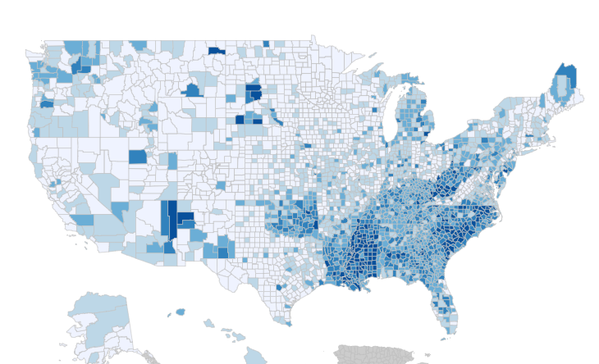
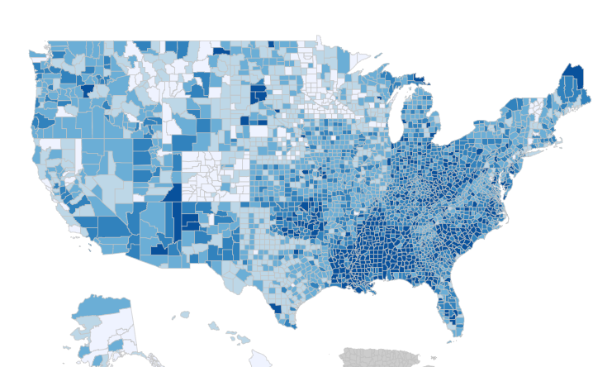
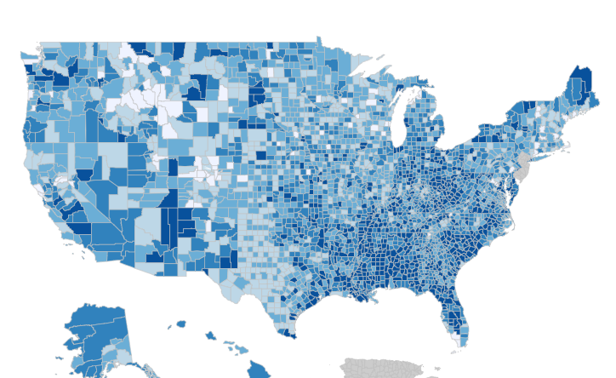
Diabetes – A Nationwide Growing Concern
Diagnosed Diabetes
Total, Adults Aged 20+ Years, 2006-2019³
2006
2012
2019
Approximately 1 in 3 clients have Diabetes¹
About 37.3 million people – or 11.3% pf the U.S. population – has diabetes (diagnosed or undiagnosed)²
The total estimated cost of diagnosed diabetes and complication from diabetes co-morbidities were $327 billion in medical costs and lost productivity in 2017²
Data Source:
¹https://www.cdc.gov/diabetes/library/reports/reportcard/national-state-diabetes-trends.html
²https://www.cdc.gov/chronicdisease/about/costs/
³https://gis.cdc.gov/grasp/diabetes/DiabetesAtlas.html#
Notes:
Alternate slide on stats (email CDC bullets) – COVID concerns on diabetes prevalence increases (At-risk)

Slide 4
Benefits of ADS
Billing for diabetes supplies can be difficult: we help clients understand their benefit structure and covered supplies.
Testing Supply Challenges
ADS understands Medicare benefits and how to bill supplies
ADS specializes in Medicare Advantage plans and formulary product
ADS is able to bill Medicare Part B, secondary, or tertiary insurance
Specialty Items Challenges
CGM & PUMP supplies are DME products that often require additional documentation
CGM insurance coverage varies between medical & pharmacy benefits; having the ability to check both allows for providing the best financial option to the clients

Slide 5
The Solution - Agent Support Program
What does the Agent Support Program Provide?
Dedicated resource for agents & clients
Diabetes supplies specialists
Client transition support
Home delivery of supplies for client's new plan
Maintaining agent of record on file
Medicare billing specialists
Educational support for agents & clients
Notes:
Detailed Content
Dedicated resource for agents to address any client’s living with diabetes needs and provide a high-level of service & support to help retain your clients.
Diabetes experts who walk your clients through their available coverage, so they maximize benefits from the plan you helped them select.
Provide a smooth and easy transition from their old plan to their new plan by providing diabetes testing supply samples during their transition period as needed.
Set your client up for home delivery of supplies before their new plan coverage begins.
Always mention the agent of record name when communicating with your clients.
Avoid common retail pharmacy billing issues and unnecessary out of pocket expenses for your clients.
Provide support and educational materials to agents on new technologies CGM, PUMP and other therapies – helping you better service your clients.

Slide 6
Agent Support Program Value Add
Higher retention rates
- Avoid rapid disenrollment of dissatisfied clients due to retail pharmacy issues
- Provide customer satisfaction with new plan prior to coverage effective date
- No-cost upgrade programs available and home delivery for all clients
- Keep clients engaged through our reorder program
Add to the value you provide your clients
- Marketing materials for agents at no cost
Easy and Convenient
- We handle all insurance verification, authorization requests and billing
- Our dedicated document collection team works with the client’s physician to obtain any necessary information for their diabetes supply request
Personalized attention
- We connect the dots between the plan, broker and supplier by always mentioning the broker’s name while enrolling new clients
- We call clients on your behalf and ensure you are listed as the agent of record

Slide 7
Why Customers Choose ADS?
ADS Exceeds Expectations
Personalized Service – Highest level of support & service with personalized resources
Quick Turnaround – Prompt replies on all inquiries from agents or clients
Convenience – A 90-day order of diabetes supplies eliminating the need to stand in line at the pharmacy
Diabetes Management – Reorder reminders or option to order online at https://reorder.northcoastmed.com/ prior to client’s supply exhaustion
Medicare Advantage Billing Specialists – Ability to bill through Part B and pharmacy benefit coverage

Slide 8
Marketing Support – Client Flyer
Additional Marketing Support
Magnets with ADS & Broker contact information
Sample testing kits
Diabetes informational kits with product & disease state FAQs
Text or call me for any Marketing support at
P: 760-712-7505 or
E: tcalder@northcoastmed.com

Slide 9
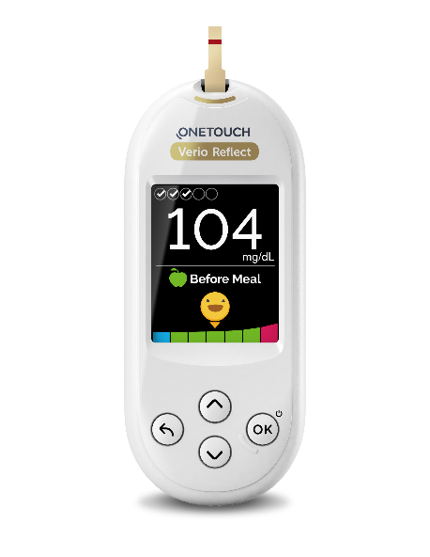
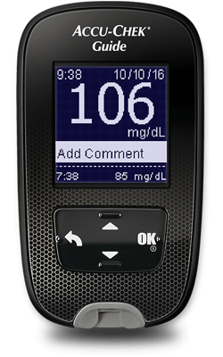
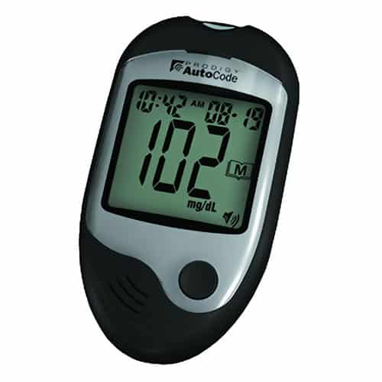
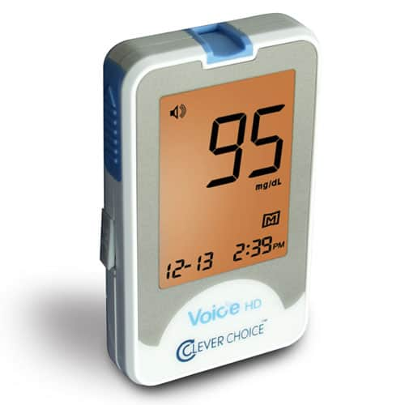
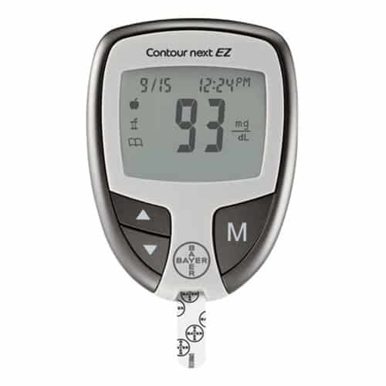
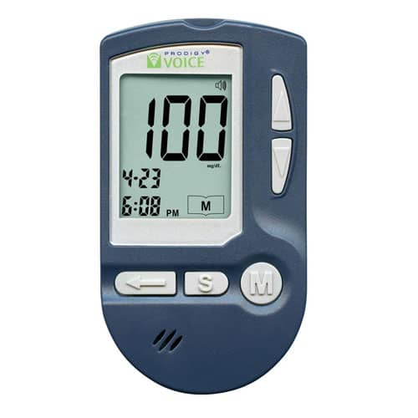
Product Portfolio – Blood Glucose Meters
OneTouch Verio Reflect
Accu-Chek Guide
Prodigy Autocode
Pharmacist Choice
Contour Next EZ¹
Prodigy Voice
*Available glucometers based on plan formularies
¹Available for UHC formularies for PUMP users

Slide 10
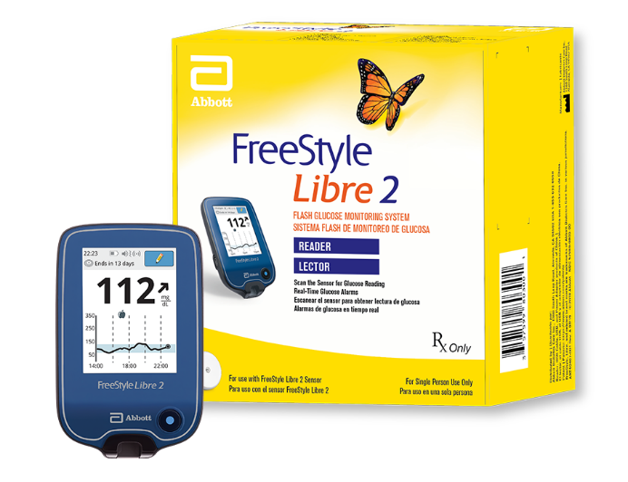
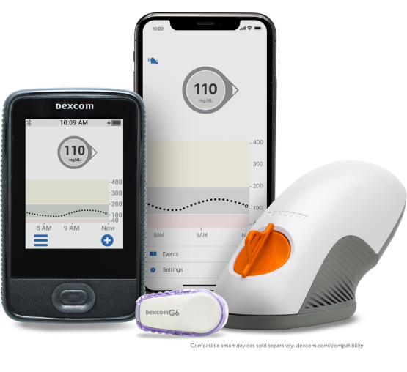
Product Portfolio - Continuous Glucose Monitors
FreeStyle Libre 2
Dexcom G6
ADS is the #1 national distributor for new Libre patients.
Access to the latest Continuous Glucose Monitors in the market which are only available from specialized in-network DME providers like ADS.
ADS confirms coverage with client prior to shipping so they are aware of their out-of-pocket responsibilities if applicable.
Notes:
FreeStyle Neo is available for Libre 2 users

Slide 11
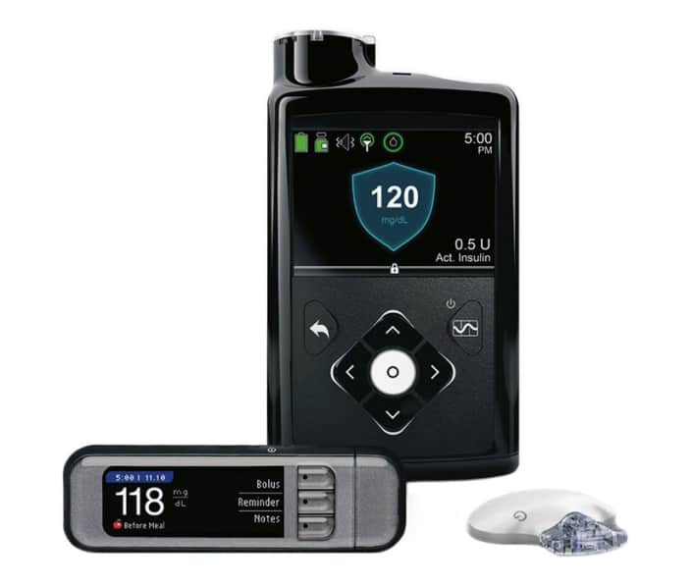
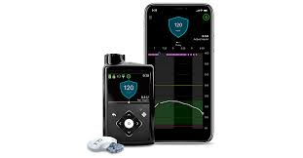
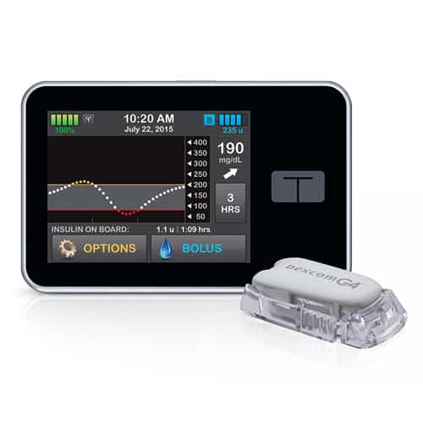
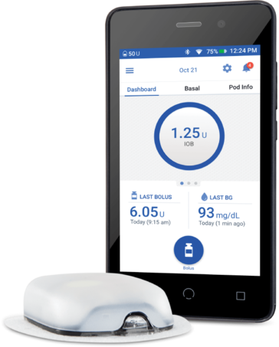
Product Portfolio – Insulin Pumps & Supplies
Medtronic 630G Pump System
Medtronic 770G Pump System
Tandem t:slim x2
Omnipod Dash

Slide 12
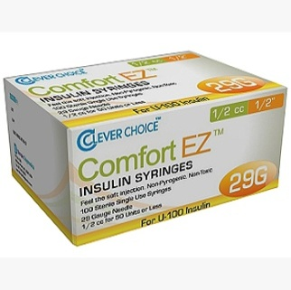
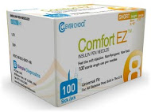
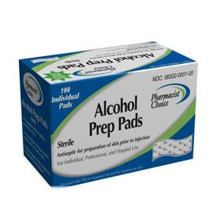
Product Portfolio – Ancillary
Syringes
Pen Needles
Alcohol Prep Pads
*Syringes and pen needles are available in multiple gauges & sizes to fit the client’s insulin needs

Slide 13
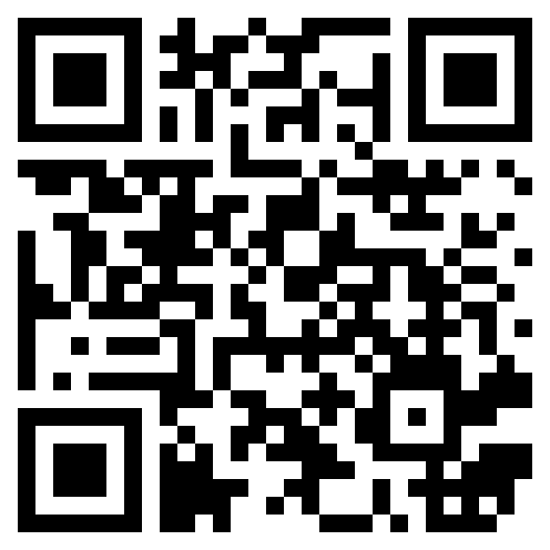
How to Get Started?
Utilizing ADS Agent Support Program is as Easy as 1,2,3…
Identify clients that have diabetes
Multiple methods to enroll clients at point of sale.
The most efficient way to refer is using the secure “Refer A Client” link
Visit our enrollment page from your mobile phone or computer
OR use QRC code
https://www.northcoastmed.com/tom-calder/
OR call (760) 712-7505
OR email tcalder@northcoastmed.com
ADS handles the rest!
Notes:
Tom Calder

Slide 14
How to Fill Out the Refer A Client Link?
Fast & Easy way to refer = Refer A Client link!
Client basic information
First Name
Last Name
DOB
Phone #
Mailing address
Insurance information
Agents' information
Agent’s Name
Agent’s Phone Number
Agent’s Email Address

Slide 15
What Happens Next?
At receipt of your client’s information, ADS handles the rest! We will:
Contact your clients on your behalf to set them up for home delivery
Have clients save our phone number on their phone (760) 827-6243
Verify Part B and RX eligibility to determine lowest out of pocket option for client
Secure prescription from the client’s physician
Obtain prior authorization if required
Ship the client’s diabetes supplies, with FREE shipping, right to their home

Slide 16
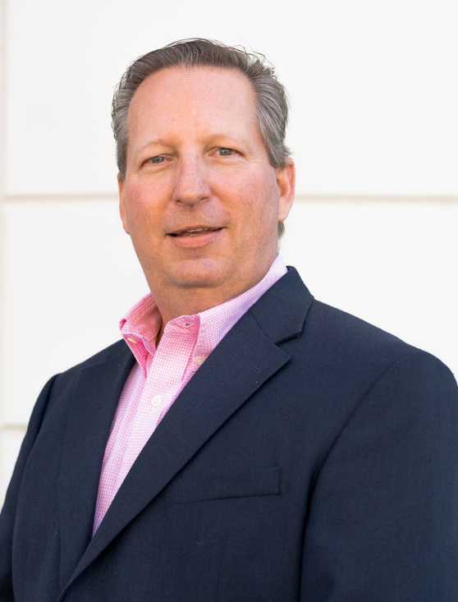
Contact Information
Tom Calder
Cell: (760) 712-7505
Direct: (760) 579-7214
Intake Line: (760) 827-6243
tcalder@northcoastmed.com
Advanced Diabetes Supply Corporate Address
2544 Campbell Place, Suite 150
Carlsbad, CA 92009
Notes:
Tom Calder

